Slide 1
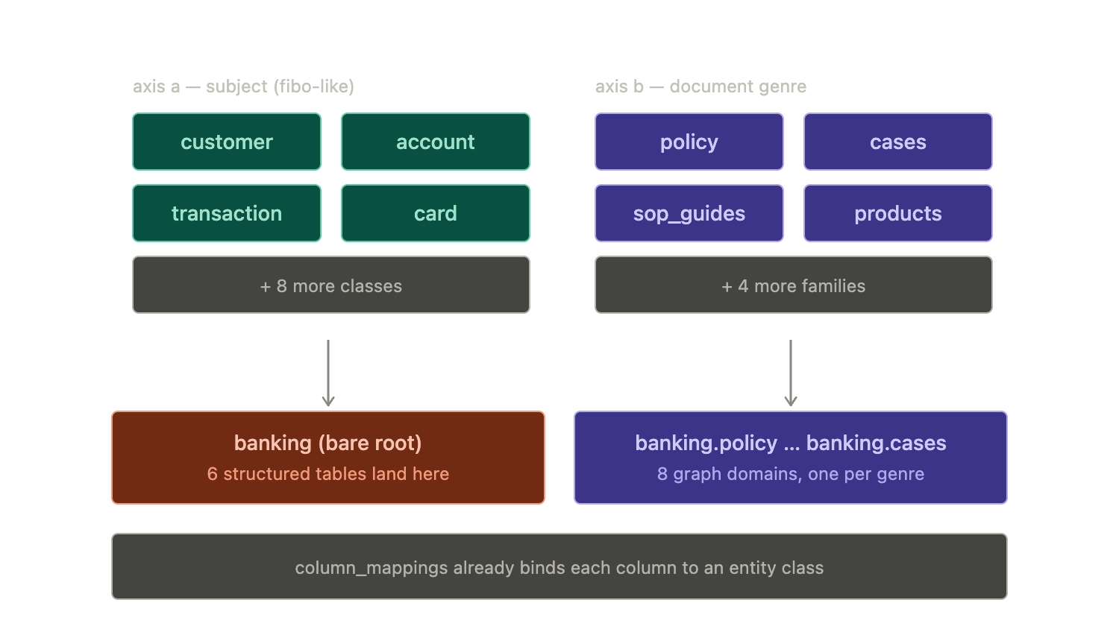

Slide 2
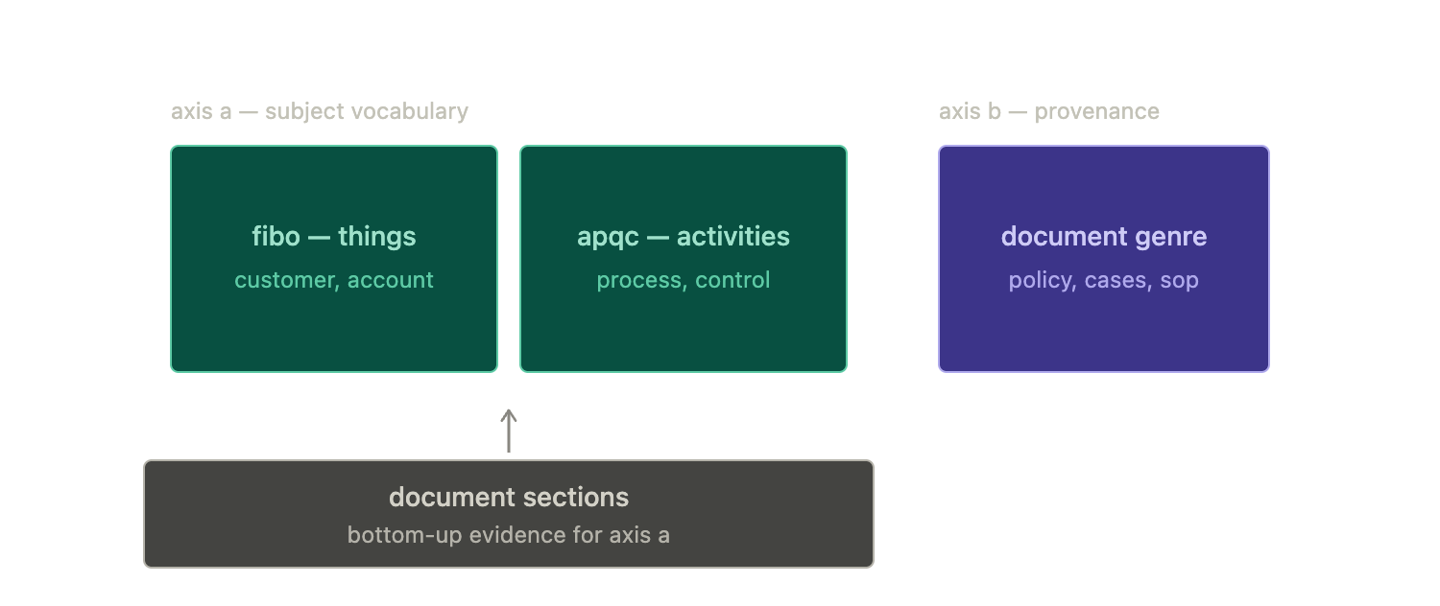

Slide 3
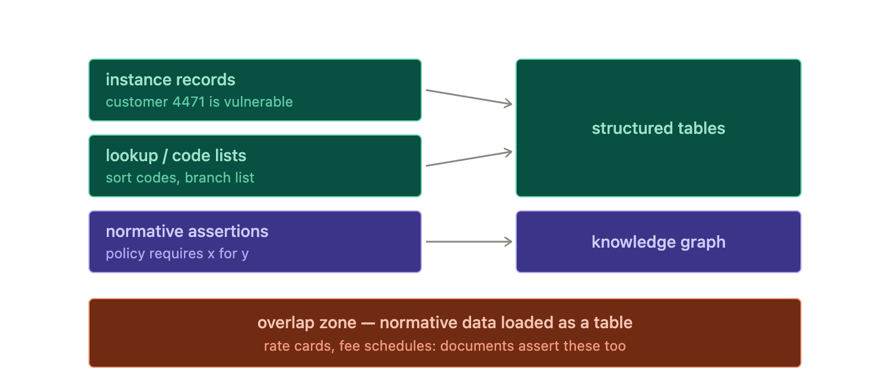

Slide 4
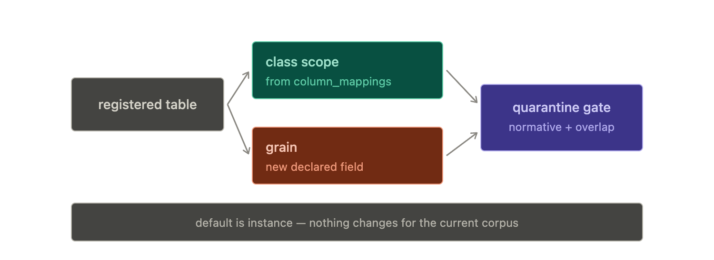

Slide 5
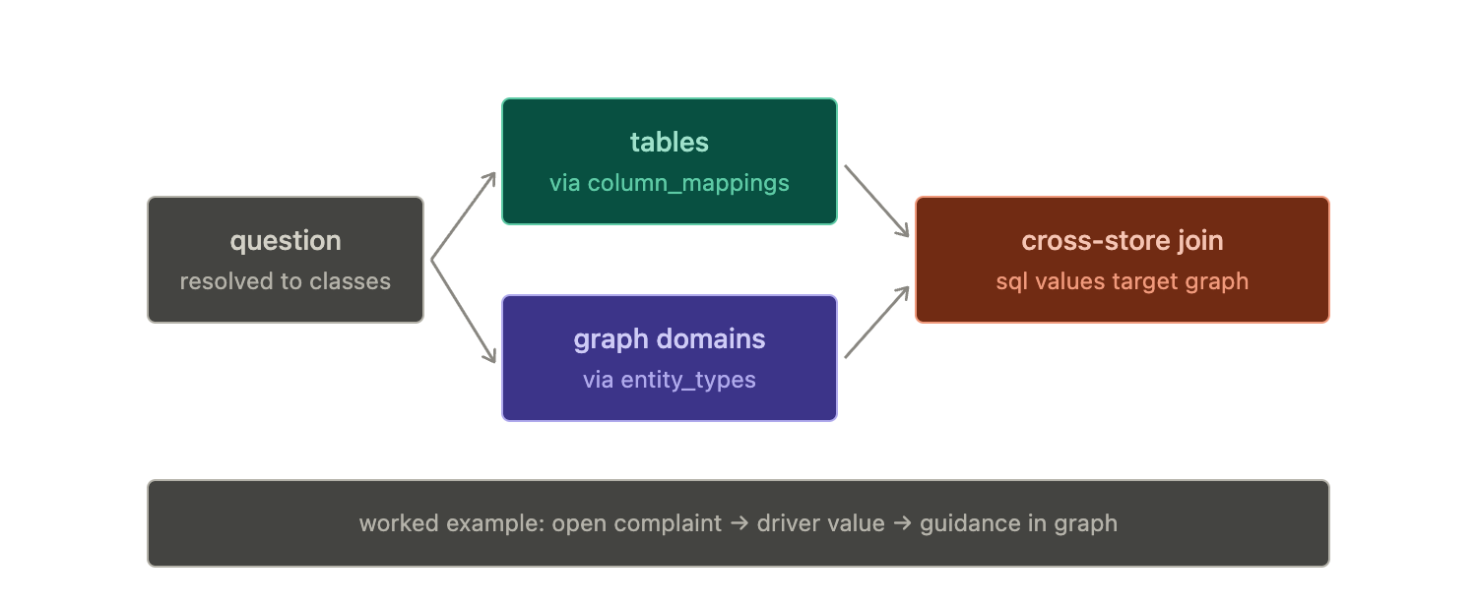

Slide 6
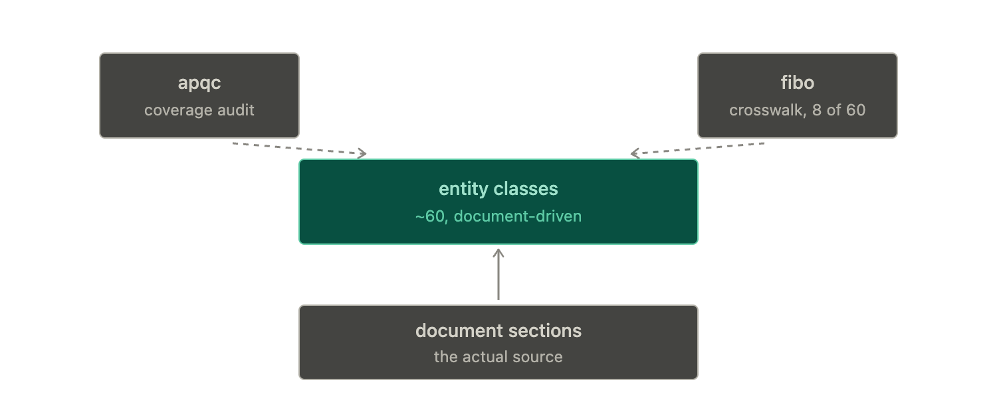

Slide 7
ARTMIND · KNOWLEDGE MODEL
Structured ↔ unstructured: where we've landed
This is so central to artmind — and to getting it right. I don't mind Option 2 (going further); we don't need to be backward compatible. Here's what I've laid out so far.
1
FIBO is good for structured data's metadata but isn't useful beyond a small subset for unstructured data extraction or organization — it can at most be a reference. However, its concept of classes is where the possibility of joining structured and unstructured data comes in.
2
APQC provides process-level keywords that are useful as a reference for defining document schemas for extraction, as it helps standardise the entity names for the graphs.
3
Domains in artmind serve at least two purposes, and if possible I want to keep it that way: (a) a filter for queries, to zoom down on a part of the graph — otherwise we'll have too many entity definitions and graph nodes to deal with for any query; (b) the extraction schemas for the KG live at a domain (or domain.xxx) level — otherwise an extraction prompt with too many entities or relationships becomes too long and complex for an LLM to practically extract graph entities from a document chunk.
4
What lives where — structured store vs. graph — is also an important consideration. We resolved that instance data and lookup data are at home in structured tables, and normative data in the graph (todo: write these definitions down more strictly). This raises the questions of "joining" and "detecting conflicts" between structured and unstructured data, both of which require a bridge. Temporality is handled by graph temporality and SCD2 for structured data.
5
The join — we still need some kind of joining mechanism between structured and unstructured data. It won't be a one-to-one relationship between entity_class and table_name, so the question we're trying to answer is: what is it? entity_class could be the answer — we need to test this out in terms of pros and cons and finalize.

Slide 8
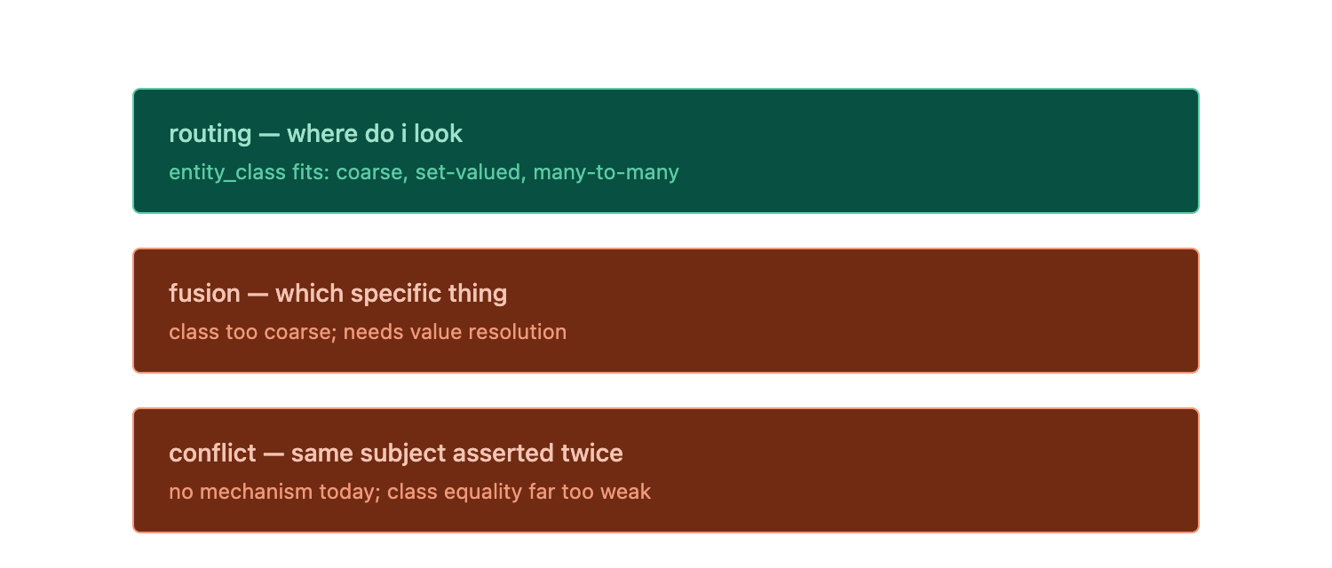

Slide 9
